Slide 1
GM Report Fiscal and Management Control Board September 18, 2017

Slide 2
Agenda
Introduction
Observations
KPIs

Slide 3
Week one
Tuesday, September 12
Green Line/Hynes to Arlington
Silver Line/Washington Street to Dudley Station
Route 45 bus from Dudley to Ruggles
Route 43 bus from Ruggles to Transportation Building
Red Line South Station
Wednesday, September 13
Daily Hynes to Arlington on the Green Line
Thursday, September 14
Kenmore to Saint Paul on the Green Line
Friday, September 15
Daily Hynes to Arlington on the Green Line
Saturday, September 16
Hynes to Park Street on the Green Line
Park Street to Kendal/MIT on the Red Line

Slide 4
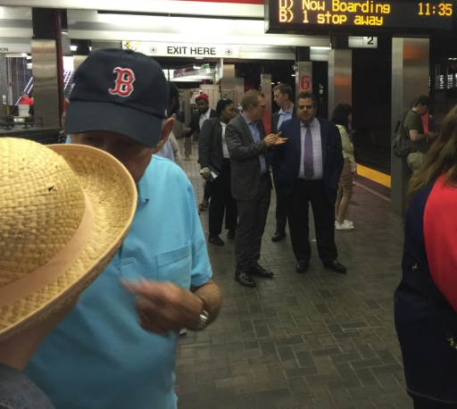
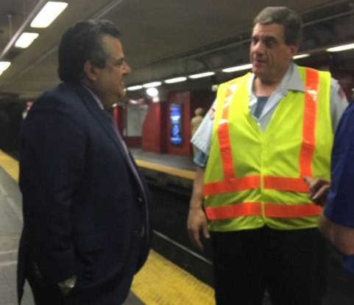
Observations
MBTA staff:
Hard working
Dedicated to the mission
Tremendous progress made
Needs and challenges still exist

Slide 5
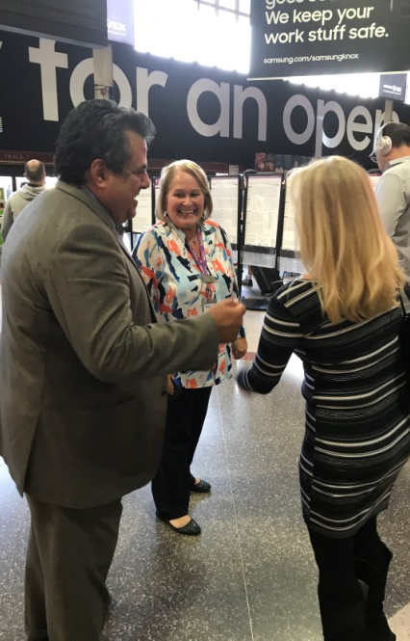
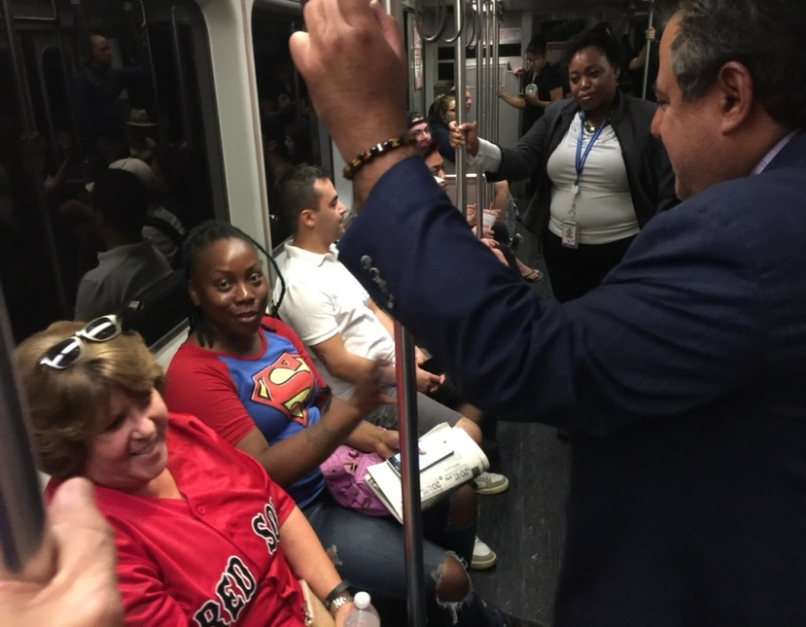
Observations
Customers:
Two recurring themes:
Customers demand a reliable system
Notion exists among some that we don’t care

Slide 6
Key Performance Indicators
Organizational Transformation
Human Capital
Customer Experience and Performance
Capital Delivery and State of Good Repair

Slide 7
Organizational Transformation
Continue forward progress on transformation
Maintain financial discipline
Advance new initiatives with a focus on customers

Slide 8
Human Capital
Fill existing key personnel vacancies
Retain and develop existing talent and institutional knowledge
Attract new talent

Slide 9
Customer Experience and Performance
This is the focus for all of our collective efforts
Will be hiring a senior customer experience lead
Further improve metrics to measure and assess our performance by our customers

Slide 10
Capital Delivery/ State of Good Repair
Spending capital dollars to maintain and modernize
Investments for the long term; impacts felt widely
Change the narrative of the MBTA

Slide 11
Confront the notion that we don’t care Nothing is further from the truth: We Care

