Slide 1
Allston I-90 Interchange Improvement Project Rail and Transit Elements
Joint MassDOT/MBTA Board
April 23, 2018

Slide 2
Allston I-90 Rail and Transit Elements – Presentation Overview
The I-90 Interchange Improvement project includes significant rail and transit elements
Commuter Rail vehicle layover
Leveraging historic rail uses at Beacon Park Yard
Crucial to meet MBTA Commuter Rail operational needs
A multimodal transit hub (‘West Station’)
New bus and private shuttle connections
All are described in the Draft Environmental Impact Report filed by MassDOT in November
There is strong public interest in the transit elements of the Interchange project

Slide 3
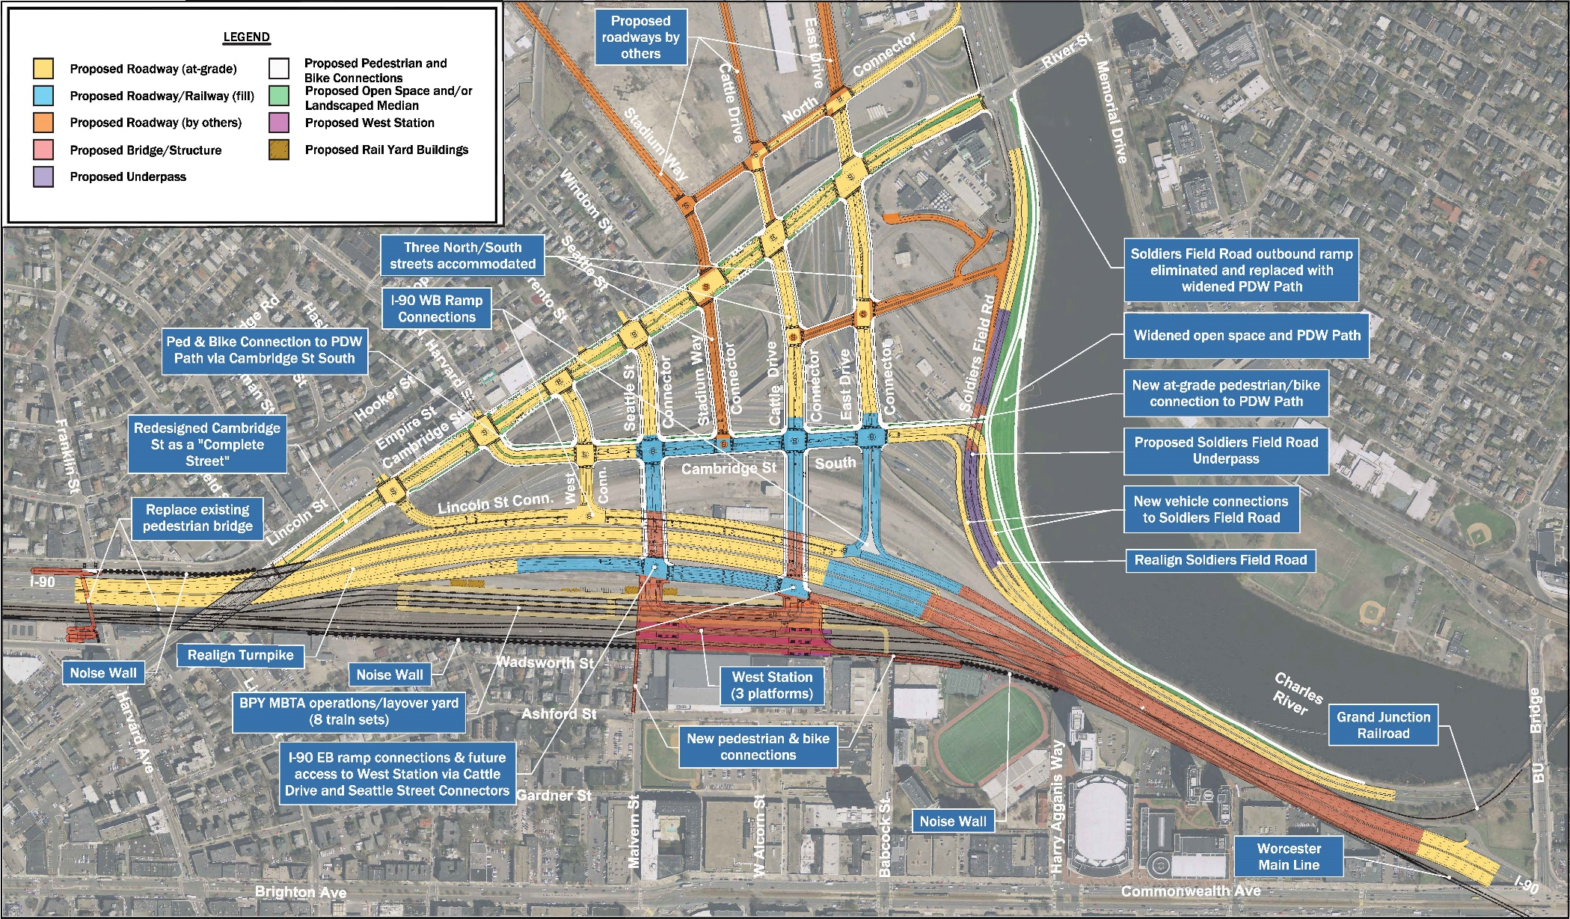
Allston I-90 Full Project

Slide 4
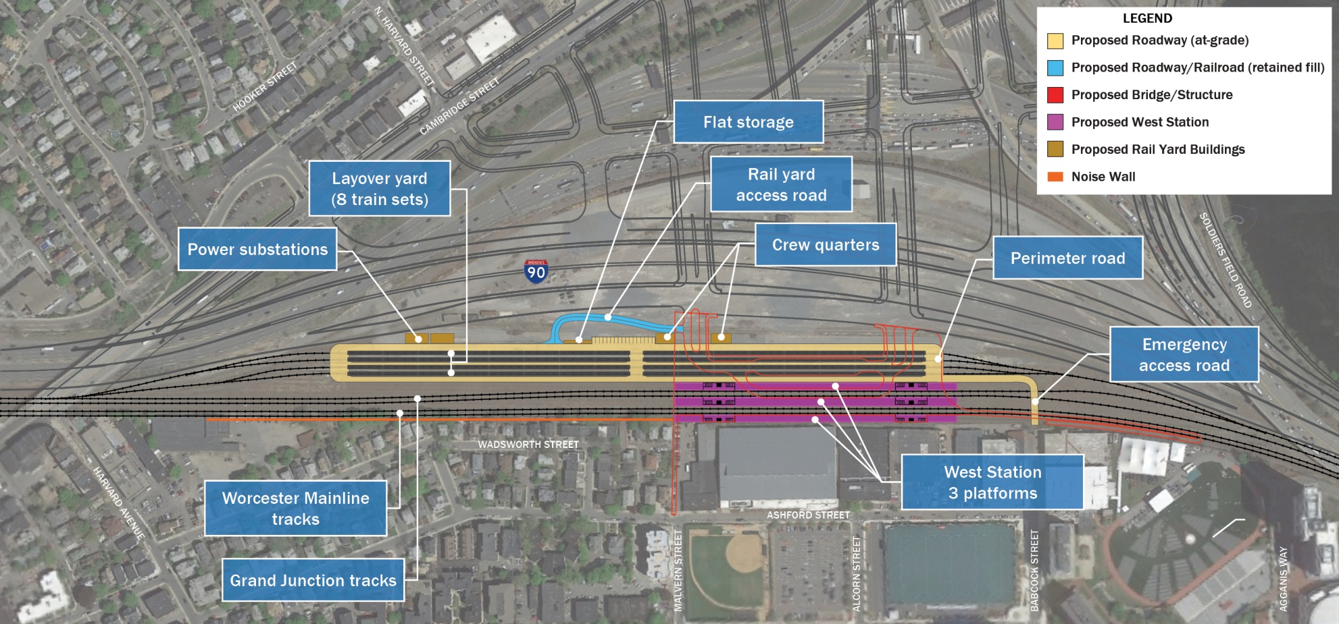
Allston I-90 Rail and Transit Elements

Slide 5
Allston I-90 Rail and Transit Elements - Context
In September 2014, MassDOT, the MBTA, and Harvard University entered into a Letter of Intent concerning the Allston I-90 Project
The existing I-90 Viaduct sits on the former site of Beacon Park Yard
The site is owned by Harvard University, which has future plans to redevelop the area into a mixed-use neighborhood including ‘decking over’ any Commuter Rail layover areas in order to create additional horizontal surface for future air-rights development
The MBTA has ongoing rights to use the Worcester Main Line, the Grand Junction, and limited layover space
The Letter of Intent committed the parties to working in their mutual interest toward the development of a project that would:
Relocate the I-90 infrastructure through the Beacon Park Yards area
Provide connections to the urban environment
Provide for rail vehicle layover and light maintenance of MBTA rail vehicles
Establish a new Commuter Rail station in the Allston neighborhood
The negotiations are ongoing and moving forward well, and will ultimately conclude in a Definitive Agreement following the completion of the MEPA process

Slide 6
Commuter Rail Vehicle Layover – Systemwide Needs
The proposed layover facilities at Beacon Park Yards would help to address a long-standing shortage of layover for MBTA Commuter Rail vehicles.
Currently, the MBTA operates without layover space for six trainsets.
Projections for 2035, prepared as part of the South Station project, estimated a deficit of layover space for 33 trainsets.
Insufficient layover can cause inefficiency, schedule disruption, congestion at the terminal stations, and delays and inconveniences for our customers.
The planning process for the expansion of Boston South Station included a comprehensive analysis of Commuter Rail layover needs and potential future layover sites.
Over many years, Beacon Park Yard has consistently been identified as one of the best and one of the very few possible sites for Boston-area Commuter Rail layover.

Slide 7
Commuter Rail Vehicle Layover - DEIR Proposal
The DEIR proposes to construct new Commuter Rail layover in Phase 2 of the project.
By the end of Phase 2, MassDOT/MBTA would construct new layover infrastructure for 8-16 trainsets, depending on the ultimate alternative selected for the overall project.
Phase 2 would also include the construction of a light maintenance facility for Commuter Rail vehicles.

Slide 8
West Station Context – The Worcester Line
The Worcester Line is the second most heavily ridden Commuter Rail line.
The MBTA runs 55 trains between Boston and Worcester every weekday.
28 inbound
27 outbound
21 of those trains are in the peak periods.
12 in the morning peak
9 in the evening peak
Travel times between Boston and Worcester vary from 1:06 to 1:31, depending on the specific train.
Any new infill station on the line adds approximately three minutes of travel time.

Slide 9
West Station Context – Nearby Stations
MassDOT/MBTA have studied additional Worcester Line stations within the City of Boston for decades.
In 2014, the MBTA opened the expanded Yawkey Station immediately outside Kenmore Square.
In 2017, Boston Landing station opened.
These two stations addressed demand for additional Commuter Rail service in the Allston/Brighton/Kenmore corridor.
West Station would be located approximately 3/4 mile from Boston Landing and 1.3 miles from Yawkey Station, with West Station in the middle between the two.

Slide 10
The Worcester Line and West Station - Context

Slide 11
West Station - DEIR Proposal
As conceived for the DEIR, West Station would:
Include three platforms with access provided by a connecting mezzanine – similar to Yawkey and Boston Landing stations – bus facilities, and local street connections to the residential neighborhood to the south.
Provide a minimum of four revenue service tracks with platform access, one pair of tracks serving the existing Worcester Main Line service and one pair serving any future service on the Grand Junction.
Limit overall station design elevation to enable future decking and air-rights development, as needed to reach agreement with Harvard.
Provide a grade-separated bus layover platform with a minimum of five bus loading berths and five bus layover berths, to accommodate future expansion of MBTA bus service and/or private shuttles.
Provide unrestricted pedestrian and bicycle connections between the neighborhood to the south across the layover yard and I-90 to Cambridge Street and the Charles River path system.
The service plan developed for the DEIR assumed 12 inbound trains (five in the peak) and 13 outbound trains (five in the peak) per weekday.
The ultimate design of a new station would depend greatly on the final configuration of the new Interchange and the rail layover facilities.

Slide 12
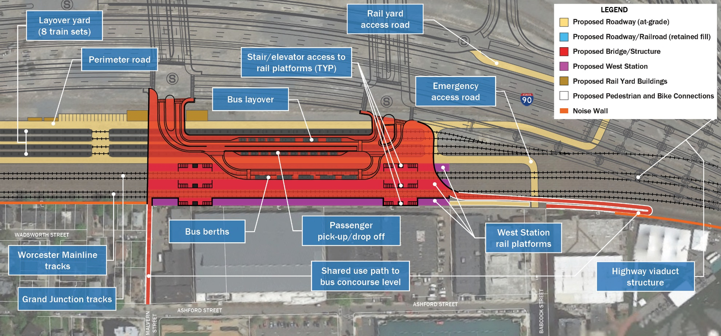
West Station - DEIR Proposal

Slide 13
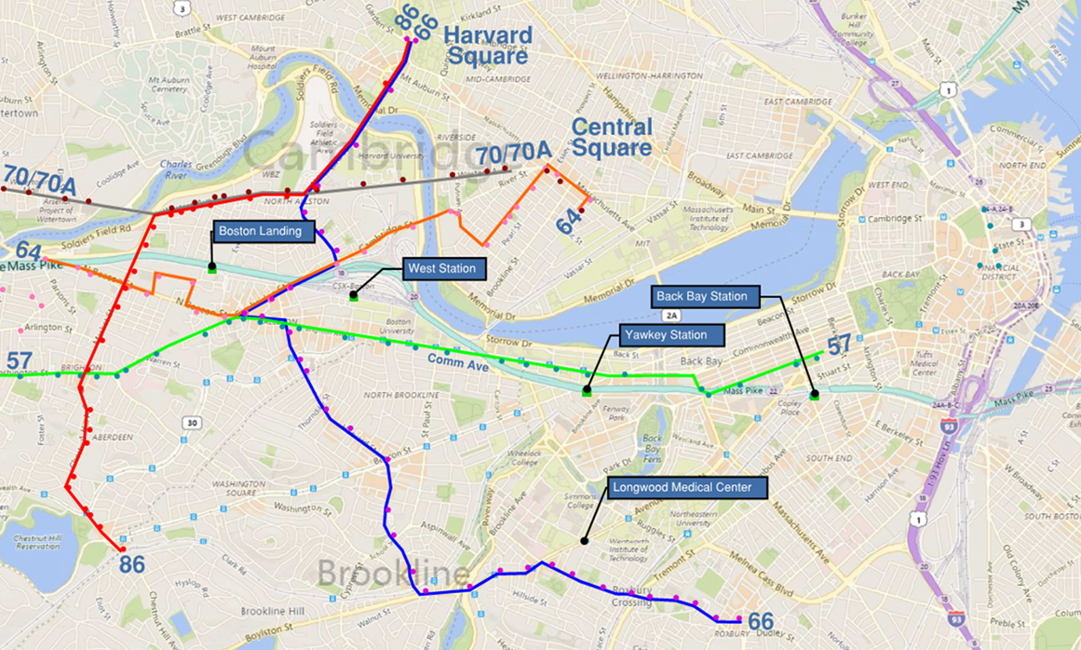
Current MBTA Services - Allston

Slide 14
Planned Work on Transit in Allston
MassDOT has begun preparing a Final Environmental Impact Report for the Allston/I-90 project.
To include additional analysis of the future ridership potential of a West Station, given limited known development scenarios
Riders at the new Boston Landing station will soon be counted and surveyed about the transportation options and choices.
Could provide insight into the need/demand for a West Station
MassDOT/MBTA is kicking off an effort with the Central Transportation Planning Staff to perform a review of existing public transit challenges in the Allston neighborhood and develop recommendations for near-term recommendations for improvements. The City of Boston will be a partner in this work.
Focused on bus service and the needs of bus riders
Six-month timeframe, to commence in May
MassDOT/MBTA is collaborating with the Cities of Boston, Cambridge, and Brookline, as well as the Metropolitan Area Planning Council, to develop a long-term transportation vision for the neighborhood that Beacon Park Yards will become.
18-month timeframe, to commence in June

